Slide 1
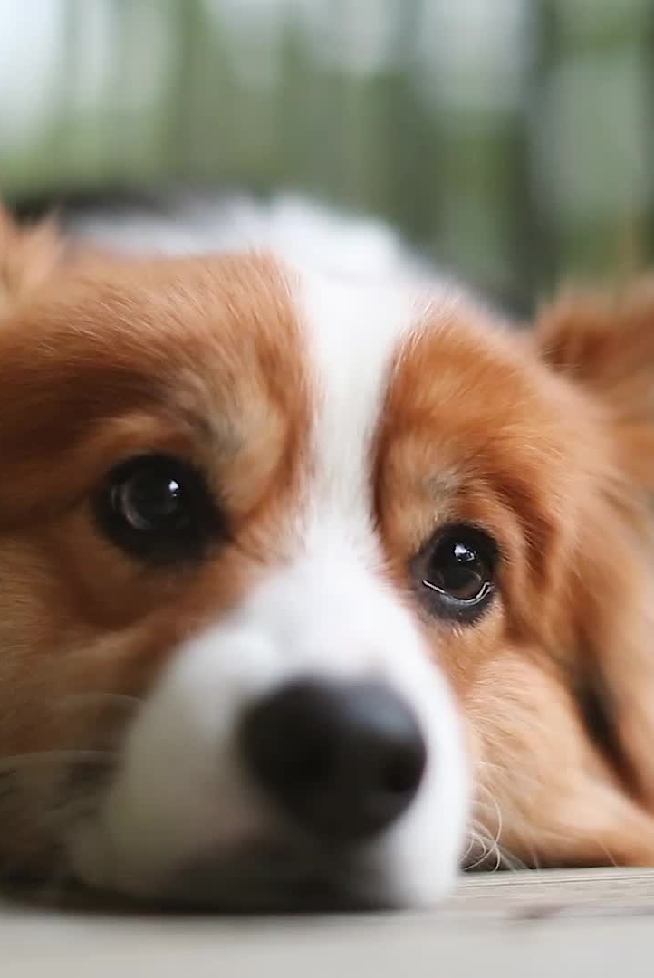
Introduction
Pet Pal,is an all-in-one mobile app designed to help pet owners easily manage their pets' health and well-being. Pet Pal offers features like pet registration, vaccination tracking, doctor booking, and pet adoption, while also creating a community for pet owners to connect and share experiences. Our mission is simple: to make pet care effortless and ensure every pet receives the best care possible.

Slide 2
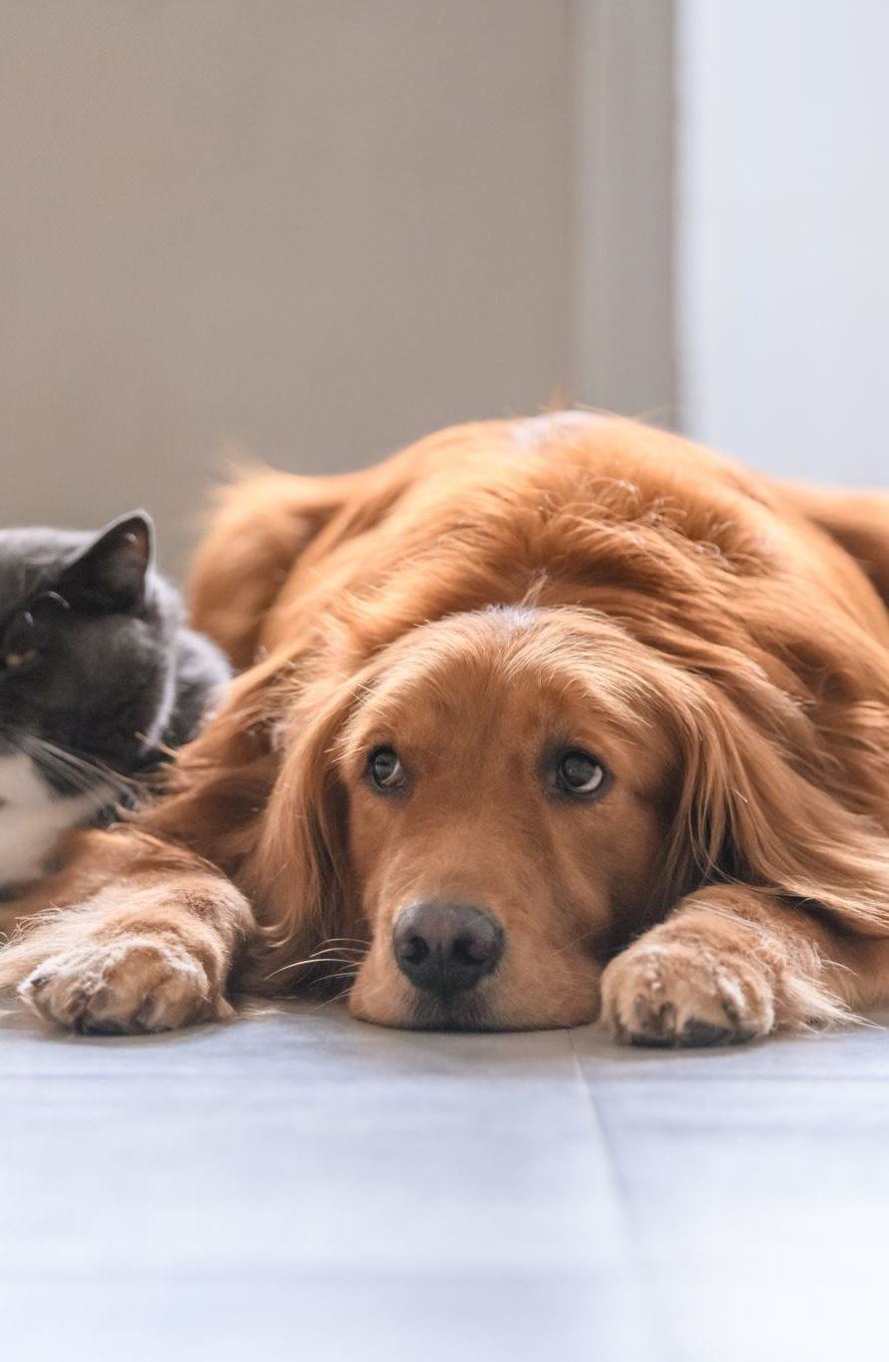
Problem Statement
Pet owners struggle with managing various tasks like tracking vaccinations,
Booking vet appointments, and adopting pets. These responsibilities are often scattered across
Multiple platforms, creating stress and inefficiencies.

Slide 3
Our Solution
PetPal is an all-in-one mobile app for pet care, offering:
Health Management: Vaccination tracking and health records
Vet Appointment Booking: Schedule and chat with vets
Pet Adoption Platform: Easily adopt pets
Lost & Found Alerts: Community support for missing pets
Pet Community Engagement: Share tips, photos, and advice.

Slide 4
Market Opportunity
The global pet care market is growing rapidly and is expected to reach over $350 billion by 2027.
PetPal taps into this trend by addressing key pain points for millions of pet owners who are looking
for convenient digital solutions to manage their pets’ care.

Slide 5
Business Model
PetPal follows a freemium model. Basic features are free, while premium services like
virtual vet consultations are subscription-based. Revenue will also come from in-app purchases,
advertising partnerships, and commissions on adoptions.

Slide 6
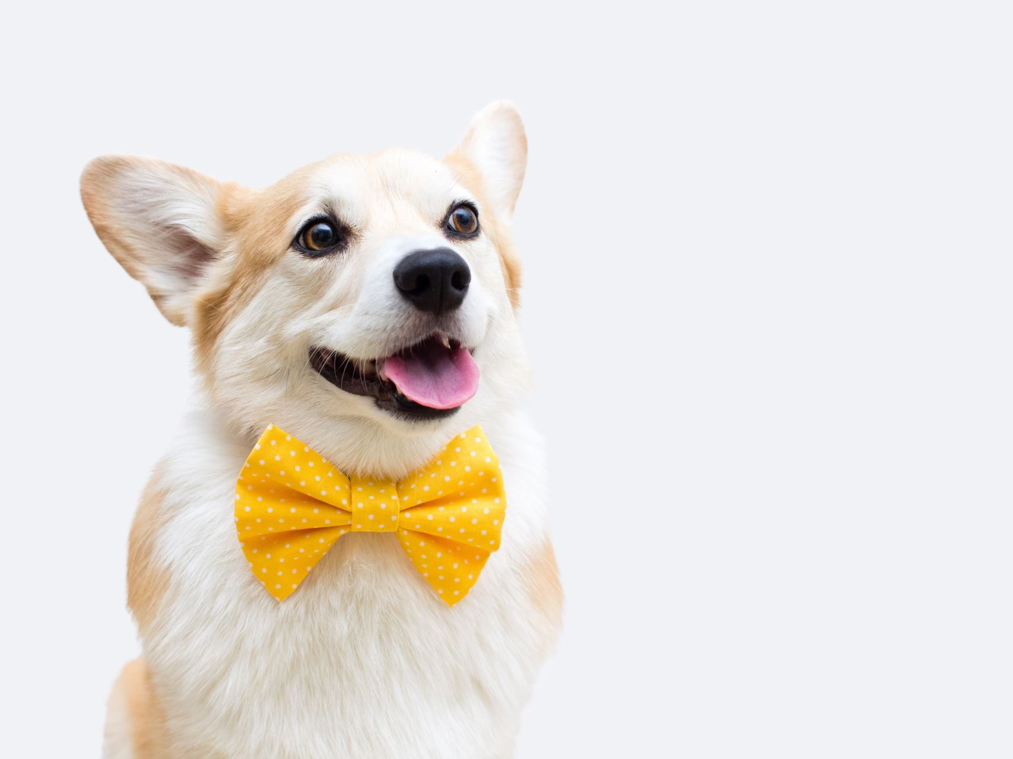
Marketing and Sales Strategy
Social Media Campaigns: Targeting pet owners on Instagram, Facebook, etc.
Influencer Collaborations: Partnering with pet influencers
Partnerships: With vets and shelters to promote PetPal
Referral Programs: Incentives for existing users to refer new ones.

Slide 7
Team
Our team includes experts dedicated to revolutionizing pet care:
Mr Nipun Lahiru, CEO: Expert in to solving the challenges faced by modern pet owners and providing a solution that brings value to both pets and their owners.
Mr Pramod Lakmal, CTO: Experienced in mobile app development
Mr Sachin Prabudhitha, Marketing Lead: Specialist in digital marketing
Mr Sanjuka Liyanage, Veterinary Consultant: Ensures health-related features are valuable.

Slide 8
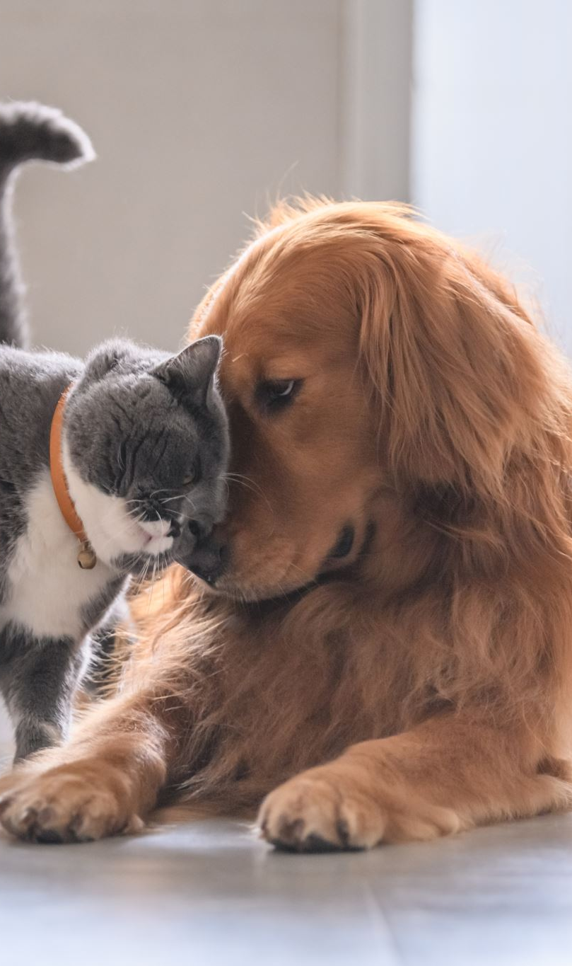
Conclusion
PetPal offers an innovative and comprehensive solution for pet owners,
combining health management, adoption services, and community features.
We are excited to invite you to join us on this journey to revolutionize pet care.
We welcome any questions and look forward to further discussion.

